Slide 1
Focus on renewable energy
13 August 2014
The transition has started, will Brunei follow?
Milo Sjardin
Notes:
20min keynote: 15 slides
What is clean energy? What are the benefits and challenges? How can solar energy be a viable option? A green future.

Slide 2
Phase change – a past example: newspapers…
2006 Founding of Twitter
1997 Invention of the smartphone
1992 Invention of the browser
1982 Invention of the internet
26 years
Source: Bloomberg L.P. Bloomberg New Energy Finance

Slide 3
Myth 1: renewable energy is still marginal

Slide 4
Similar investments are now going into clean energy as in fossil power
New investment in clean energy 2004–13 ($bn)
Clean Energy = Biomass, Biofuels, Energy Smart Technologies, Geothermal, Small scale hydro, Marine, Solar, Wind
Note: Total values include estimates for undisclosed deals. Includes corporate and government R&D, and spending for digital energy and energy storage projects (not reported in quarterly statistics)
Source: Bloomberg New Energy Finance

Slide 5
The transition started in Europe but is continuing in asia pacific
New investment in clean energy 2004–13 ($bn)
H1 2014 – YOY :
APAC +9%
AMER +28%
EMEA -3%
Source: Bloomberg New Energy Finance

Slide 6
Renewable Growth will continue to grow exponentially
Solar and wind capacity, IEA and BNEF (GW)
Current PV & wind capacity is where IEA 2010 thought we would be in 2024 (GW)
BNEF - 2014
BNEF - 2011
IEA - 2013
IEA - 2010

Slide 7
And global Additions of fossil capacity will decline while renewables will rise
GW
OECD
GW
OECD
GW
Non-OECD
GW
Non-OECD
Source: Bloomberg New Energy Finance
Source: Bloomberg New Energy Finance

Slide 8
Myth 2: renewables are expensive

Slide 9
Wind is already competitive and Solar has gone through major cost reductions
Levelised cost of electricity production ($/MWH)
Note: LCOE excludes impact of subsidies and other support schemes.
Source: Bloomberg New Energy Finance

Slide 10



clean energy can already directly compete in good locations
$37/MWh onshore wind
$37/MWh geothermal
$80/MWh solar
Note: Levelised cost of electricity excludes impact of subsidies.
Source: Bloomberg New Energy Finance

Slide 11
Even solar does not always need subsidies
Germany: PV subsidies versus electricity prices
Source: Bloomberg New Energy Finance

Slide 12
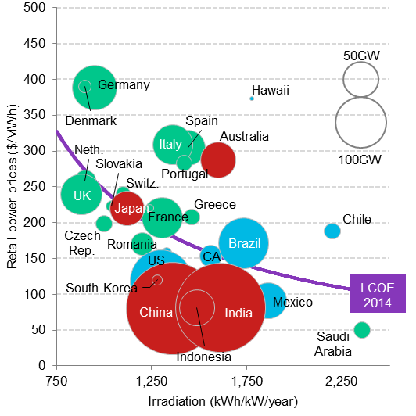
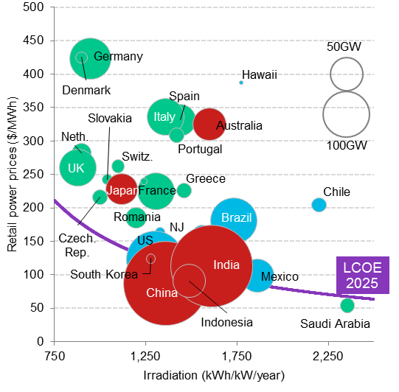
Global residential-scale PV system economics: now and in a decade
2014
2025
Note: NJ, New Jersey; CA, California. Source: Bloomberg New Energy Finance
Note: NJ, New Jersey; CA, California. Source: Bloomberg New Energy Finance
Notes:
Brunei: Under the new tariff, there will be three tiers for power rates. The first tier, which covers consumption of up to 500 kilowatt hours, will cost $0.01 per kWh. In excess of the 500 kWh up to 1,500 kWh, power will cost $0.10 per kWh. The last tier, covering consumption of over 1,500 kWh, power will cost $0.15 per kWh.

Slide 13
In brunei renewables are still relatively more expensive than other sources
Brunei levelised cost of electricity for renewables ($/MWh)
SE Asia
gas/coal
Source: Bloomberg New Energy Finance.
Notes:
Brunei opened its first solar power plant, the 1.2 MW Tenaga Suria Brunei Photovoltaic Power Plant, on 26 May 2011 by Sultan Hassanal Bolkiah. The plant powers up around 200 houses in the nation.^{[1][2]}

Slide 14
Technology dependence will lead to lower costs while fuel dependence to higher
Evolution of solar PV LCOE relative to alternatives, 2012-30 ($ nominal/MWh)
PV capacity factor in SE Asia is relatively low at 16%
NE Asia LNG
Utility PV: 16-18% CF
SE Asia gas
Wholesale market competitiveness
SE Asia coal
US gas
Source: Bloomberg New Energy Finance

Slide 15
Myth 3: power systems cannot deal with variable renewables

Slide 16
Many countries are successfully dealing with high shares of variable renewables
Germany: installed capacity 2013 (GW) and
electricity consumption 1991–2012 (TWh)
Germany H1 2014: 17% of power from wind & solar
Spain 2013: 24% from wind & solar
Italy 2013: 13% from wind and solar
Texas 2013: 10% from wind
Tamil Nadu, India 2012: 12% from wind
Note that some days this can be 30-50% of power
Note: “Hydro” includes pump storage, run of river and dam storage.
Source: Bloomberg New Energy Finance, Federal Network Agency, BMWI.

Slide 17
From centralised power to distributed power
APAC: investment by type 2003–H1 2014 ($bn)
Asset finance
Source: Bloomberg New Energy Finance

Slide 18
Lessons from other countries
Subsidies can initially be useful to create awareness and kick-start a country’s renewable sector
With subsidies it is essential to put limits in place: capacity cap, auction limits, competitive process
Create the conditions so that companies can generate their own electricity rather than relying solely on the utilities
Phase out any subsidies (including those for fossil and power) over time so that technologies compete in their own right
Integrate renewable build into the country’s overall generation and transmission plan

Slide 19
Clean energy deployment: drivers and barriers
drivers
barriers
Policy incentives: feed-in tariffs, renewable targets, tax breaks
Technology cost reductions
Carbon emission and local air pollution reductions
Energy security concerns
Domestic manufacturing
Perception of technology risk
Perception of high cost
High upfront cost
Lack of expertise (in some countries)
Small project size (on average)

Slide 20
conclusion

Slide 21
Conclusions
Renewables are not marginal anymore with more renewable capacity being installed than fossil power and a projected 67% of future investments
Renewable are not expensive anymore with onshore wind available at the same cost as coal and gas and PV costs rapidly coming down such that it is already at retail power parity
Renewables are not difficult to integrate, but it requires planning and a different way of operating the power system

Slide 22
Bnef: 200 experts across six continents
Europe
90
London
Asia
Pacific
North America
35
40
Munich
Zurich
Beijing
New York
Tokyo
San
Francisco
Washington DC
Seoul
New Delhi
Hong
Kong
Africa
30
Singapore
South
America
5
Sao Paulo
Cape Town
Sydney

Slide 23
Products to help you understand the future of energy
Solar
Wind
Other
Renewables
Gas
Energy Smart Technologies
Advanced
Transport
Carbon &
RECs Markets
Americas
Europe, Middle East
& Africa
Asia Pacific
Notes:
Exclusive daily news feeds
On-call analysts
700 research notes/year
Transparent datasets
Sector-leading forecasts
Proprietary models
Policy database
Workshops and events

Slide 24

THE RIGHT TOOLS AND
ANALYSIS TO FIT YOUR ROLE
Investment &
Finance Professional
Economics,
Finance & Markets
Policy & News
Supply Chain & Technology
Strategy & Business Development Executive
Policy
Analyst & Regulatory Professional
Market & investment forecasts | Country profiles & market data | Technology analysis & forecasts
Levelized cost of electricity analysis | Policy & regulatory analysis | Competitive landscapes & value chain analysis
Asset & deal databases & valuation tools | Breaking news & ‘First Takes’ | Price indexes & benchmarks
Trader &
Trading Strategist
Sales &
Marketing
Executive
Researcher

Slide 25
Copyright and disclaimer

Slide 26
Milo Sjardin
  msjardin@bloomberg.net

